Slide 1
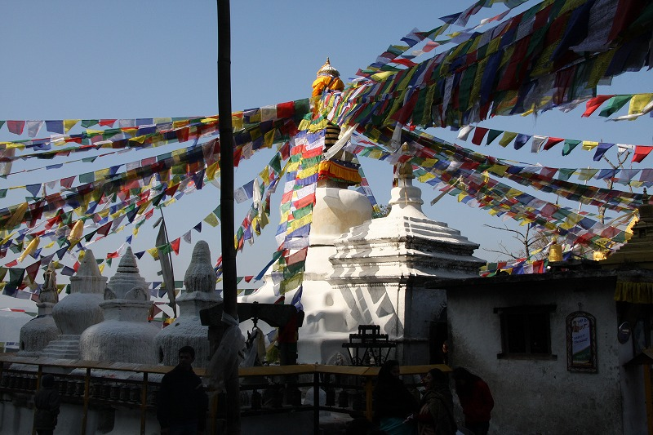

インキュベーション研究拠点
「広島の知と経験を基盤とした実践的平和構築学確立のための研究拠点」
2016年度第3回研究会
Hiroshima Active Peacebuilding Research Initiative
The 3rd Study Session
Date: Friday, 29 July 2016
Time: 17:00-19:00
Venue: Medium Conference Room,
Graduate School of Social Sciences 1F
【Presentation 1】17:00-18:00
India's path toward accommodative political development: achievements and issues
Kazuhiro ITAKURA Ph.D.
Special Postdoctoral Researcher, Global Career Design Center,
Hiroshima University
【Presentation 2】18:00-1900
Chinese cross-border development investment and the "Politics of Buddhism“
in Himalayan border region
Yusuke BESSHO Ph.D.
Research Fellow
Graduate School for International Development and Cooperation,
Hiroshima University
Medium: English
The Seminar is open to public, and no registration is required.
Contact: 「広島の知と経験を基盤とした実践的平和構築学確立のための研究拠点」事務室
Hiroshima Active Peacebuilding Research Initiative Office
E-mail: hipec@hiroshima-u.ac.jp

